Slide 1


Generative AI
Full Stack Developer
01

Slide 2
Course B : RAG
Retrieval Augmented Generation
05

Slide 3
01 - Embeddings & Vector Search
03

Slide 4

Vector Similarity Search
Exercise (Warm-up):
Think of 2 apps you use daily that rely on "finding something similar"
04
Notes:
(e.g., Google Search, ChatGPT w/ RAG).

Slide 5



Why Do We Need Vector Similarity Search?
Computers don't understand text like humans do
We need to convert text into numbers (vectors) for processing
Goal: Find similar content quickly among millions of items
Examples:
"Find documents that answer my question"
"Show me knowledge base articles similar to this query"
"Search for passages with similar meaning"
05

Slide 6

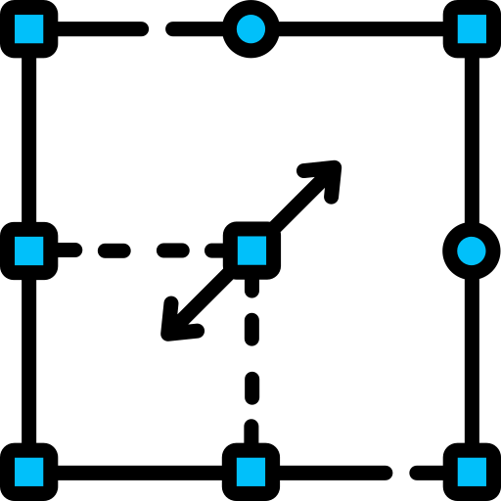

Traditional keyword search vs. meaning-based search
Keyword Search
Vector Search
Matches exact words only
Misses synonyms and related concepts
Limited understanding of context
Understands semantic meaning
Captures related concepts
Context-aware matching
Searching "how to reset password" in a keyword system may
miss "forgot credentials" — vector search finds both.
06

Slide 7
What Are Text Embeddings?
Embeddings = Converting text into lists of numbers
Think of it as a "coordinate system" for words and sentences
Similar words get similar numbers
"cat"
[0.2, 0.8, -0.3, ...]
"dog"
[0.3, 0.7, -0.2, ...]
"airplane"
[-0.8, 0.1, 0.6, ...]
Close in vector space
Far in vector space
These numbers help computers understand meaning
Different methods exist - from simple to sophisticated
07

Slide 8




Text Embeddings
Key Properties:
Common Models:
• Capture semantic relationships
• Enable mathematical operations on language
• Transform text into a form computers can process
• Word2Vec, GloVe (word level)
• BERT, GPT (contextual embeddings)
• Sentence-BERT, OpenAI Embeddings, Gemini Embeddings (sentence/paragraph level level)
Mini Practice:
Which two words do you think would be closer in embedding space:
Coffee
&
Tea
OR
Coffee
&
Table
Think about semantic relationships versus physical relationships
08

Slide 9
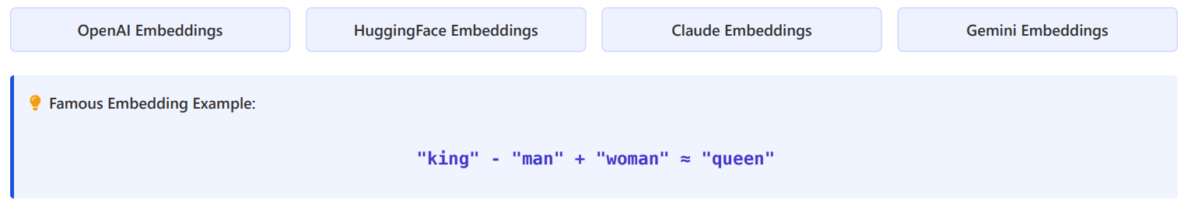
Introduction to Semantic Embeddings
Modern approach that captures word meaning
Words with similar meanings get similar number representations
Created using machine learning on large text datasets
Examples:
These vectors are dense (no wasted zeros) Unlike one-hot encoding, semantic embeddings use all dimensions efficiently
15

Slide 10
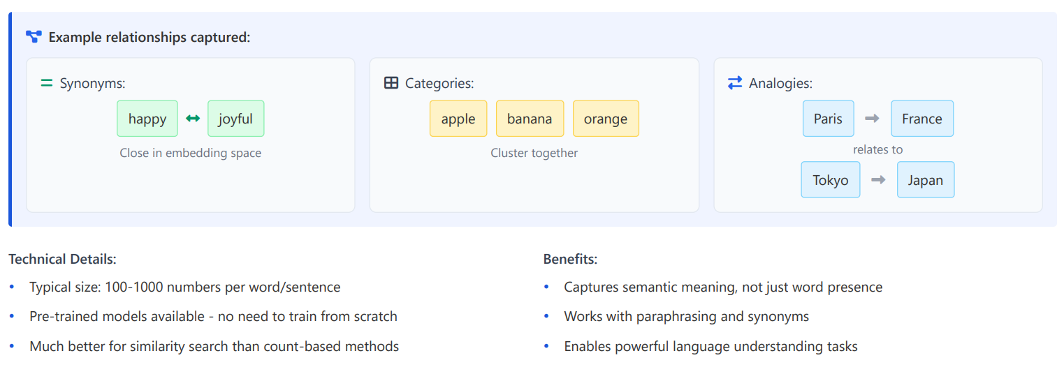
Semantic Embeddings in Action
16

Slide 11
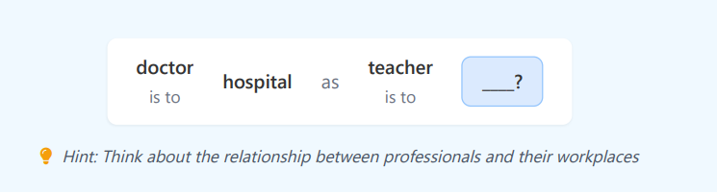
Semantic Embeddings in Action
Practice: Fill in the blank:
17

Slide 12
Q / A
21

Slide 13
Thanks
22

